Slide 1

Welcome to R-Ladies Singapore!
2024-12-21

Slide 2








About me
Research Assistant
Digital Medicine
Cardiovascular health & sleep
RStudio (3+ years)
Class of 2021 (Psych major + French Studies minor)

Slide 3



Contents
Basic setup for RStudio
Where to look to download R & RStudio?
Making sure latest versions used.
Introduction to dplyr
Downloading dplyr;
Introduction to basic verbs in dplyr
Iris data set (Hands on!)
Why is it interesting and significant?
dplyr verbs application
Basic plotting

Slide 4


Basic setup for R – Downloading R (4.4.2)
For Windows Users
For Mac Users
Head to cran.r-project.org;
Select Download R for Windows
Click on “Install R for the first time”
Click Download R for windows, then open downloaded file.
<Setup wizard should pop out> Select the language you’d like to use during the installation.
Once done, click ”Ok to continue”.
Info tab will show up. Click “Next”.
Choose directory to save R. Default is C:\. Once done, click “Next”.
Depending on your computer, you can choose amongst
User installation;
32/64-bit User installation;
Custom installation.
Start up customization will show up next. Choose either “Yes” or “No”.
Choose folder on where to save R, either the C:\ or the R folder that was created. Once done, click “Next”.
You may choose to create additional shortcuts for R on the desktop. This is optional.
Once done, hit “Next”, then click “Finish”
Head to cran.r-project.org
Click download R for MacOS
Do note difference in .pkgs for different Macbook generations:
R-4.4.2-arm64.pkg (Silicon chip – M1/2 Macs);
R-4.4.2-x86_64.pkg (Intel chip)
Once file download is complete, click on it to open R installer. Follow instructions in the installer.
Once done, you should see a green tick (. ) indicating download complete.
Click “close”

Slide 5

Basic setup for R – Downloading RStudio (2024.12.0+)
For Windows Users
For Mac Users
Head to https://posit.co/downloads/
Click on the button on the right of the screen: “2: Install RStudio”. The button should say “DOWNLOAD RSTUDIO DESKTOP FOR WINDOWS”.
Once the package has downloaded, “Welcome to RStudio Setup Wizard” should open.
Click “Next” and follow the guidance provided in the setup wizard.
Once done, R and RStudio will open automatically.
Head to https://posit.co/downloads/
Click ”DOWNLOAD RSTUDIO”
Once file download is complete, click to open the installer.
Drag RStudio into your ”Applications” folder
Once installation is complete, R and RStudio will open automatically.

Slide 6
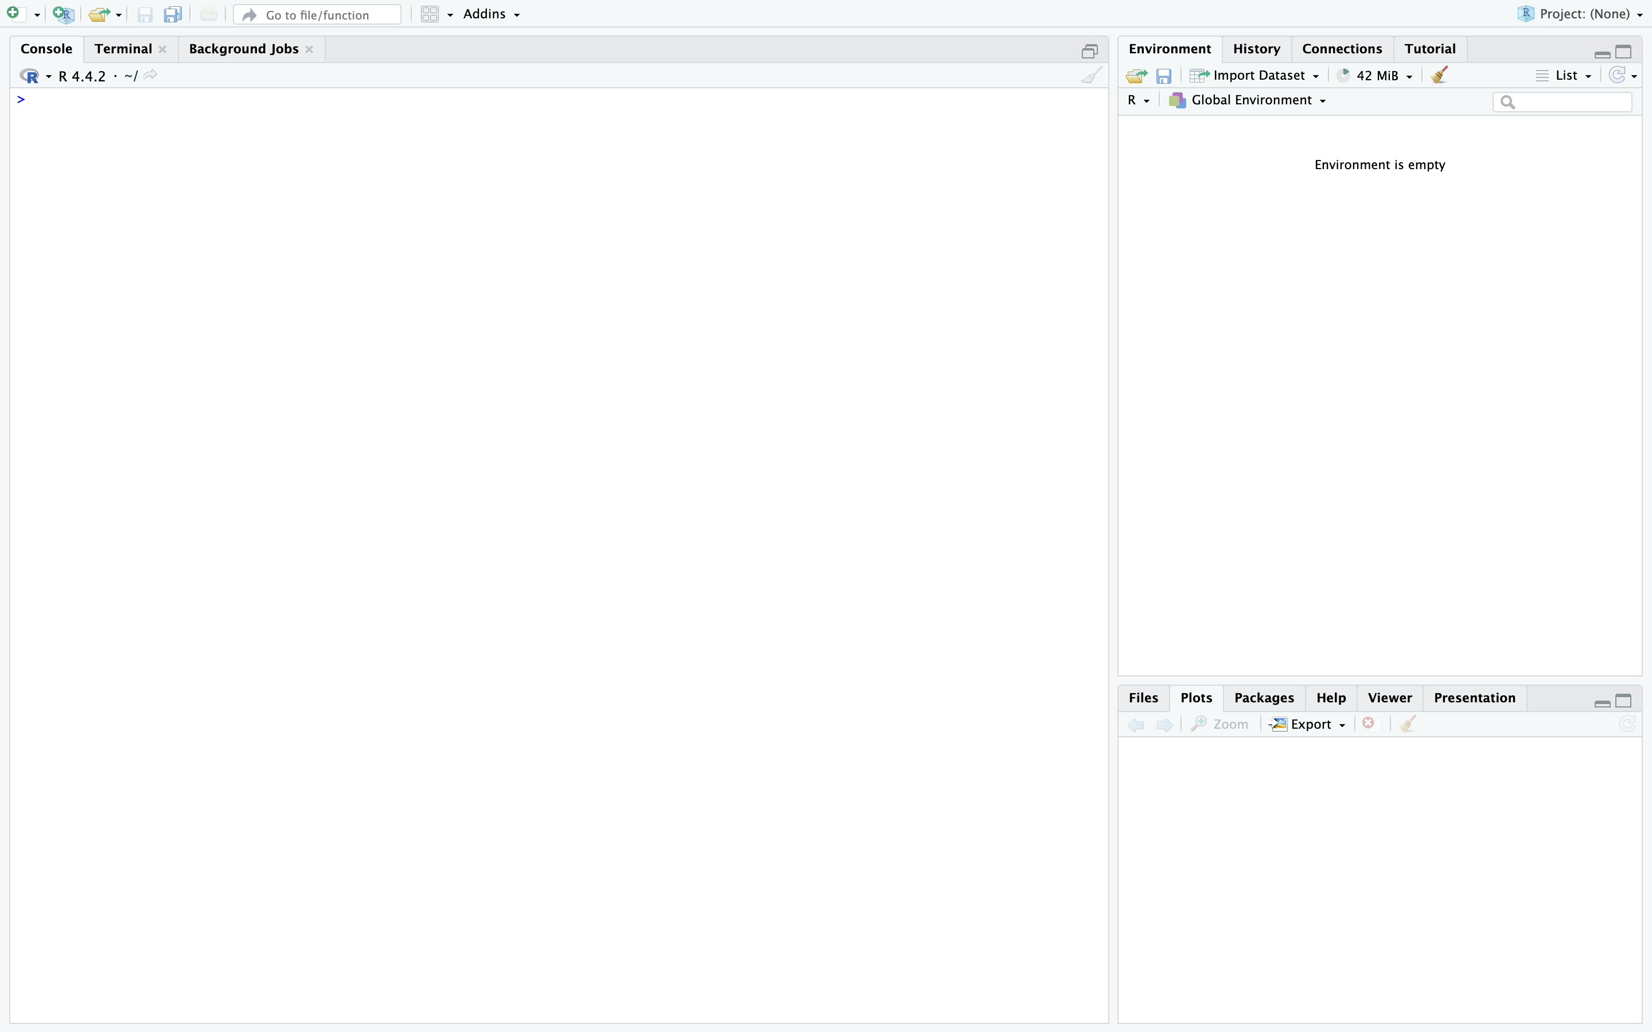
Brief introduction to the RStudio interface
New script:
→ Clean sheet to start coding
→ Usually used for new projects
Console:
Running functions
Type function then hit “Enter” to run
R Project
→ For organizing multiple scripts into a single list of files
Terminal:
→ Providing access to the system shell from within the RStudio environment.
Background jobs
Jobs to run in a separate dedicated R session.
All variables available from current work session accessible in the background job session.
Doesn’t affect current script’s outputs;
Can be started manually or programmatically;
Good for interactive, ad-hoc usage.
This is where you will see your data and its specs (e.g., #row & #columns);
In R, the tables/spreadsheets are known as data frames.
Can get cluttered quick: up to you to manage.
→ Plots will show up here;
→ Expands and contracts in proportion to the window size;

Slide 7

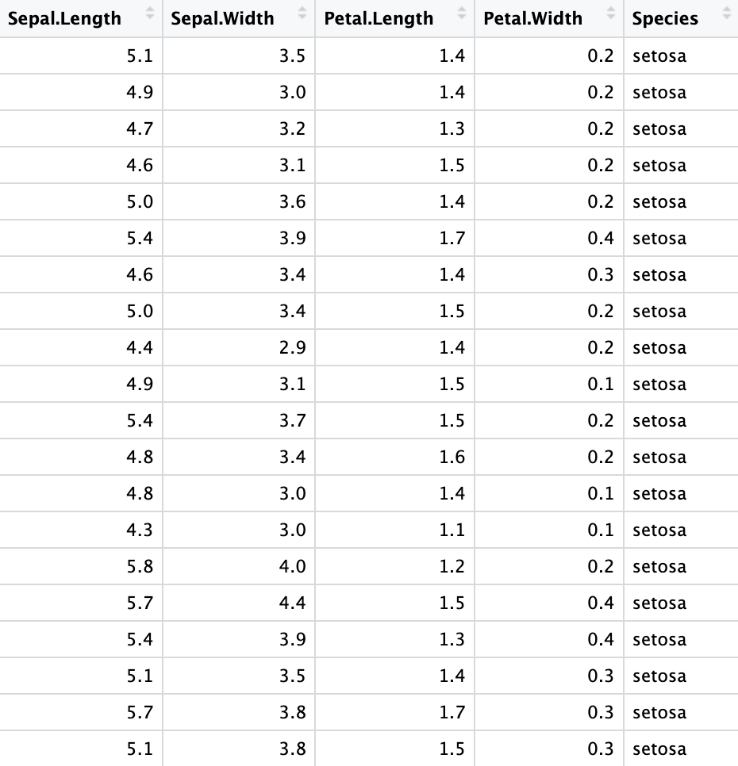
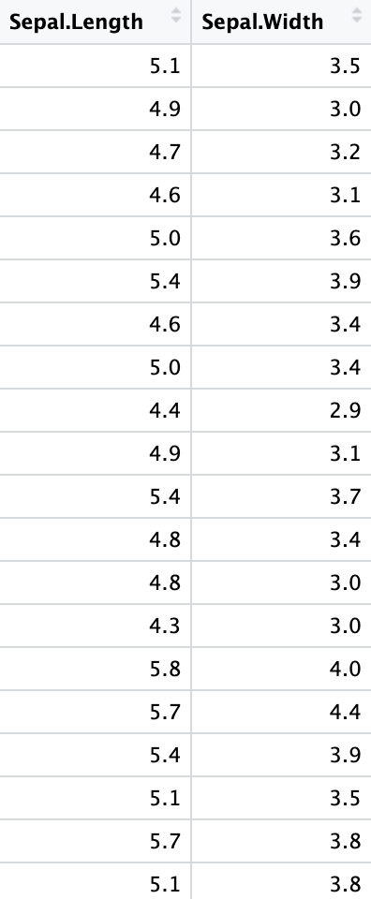
Introduction to dplyr (“The plier”)
1. select(): choose which columns to keep in the data frame
>
view(iris)
>
IRIS_SepalSelect_DF ← iris %>%
select(Sepal.Length, Sepal.Width)
10
Fundamental grammar for data manipulation in R
Functions/commands for data manipulation
Summoned by calling library(dplyr) in script

Slide 8
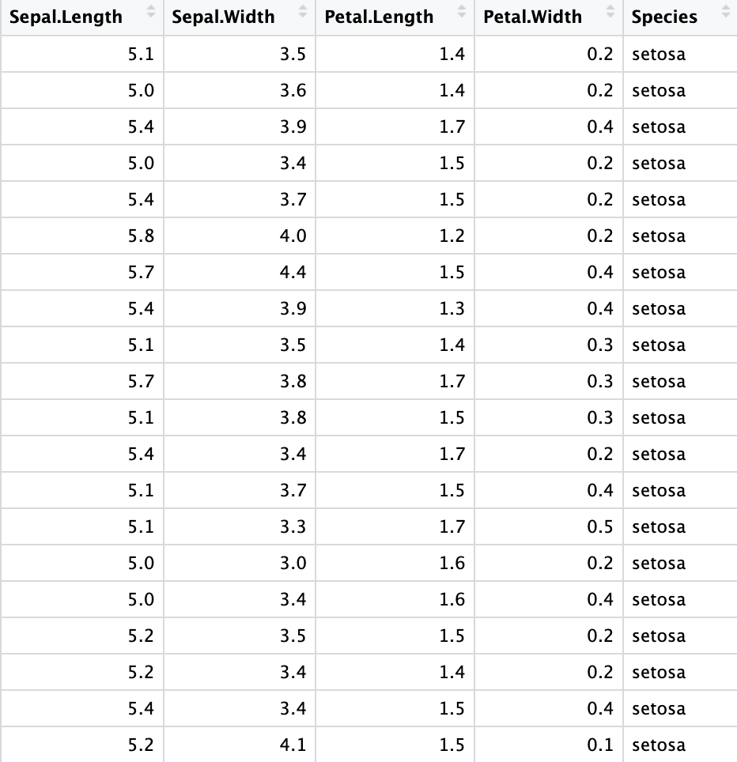
Introduction to dplyr (“The plier”)
2. filter(): choose which rows to keep in the data frame
>
>
IRIS_SepalFilter_DF ← iris %>%
filter(Sepal.Length >= 5)
view(iris)
Fundamental grammar for data manipulation in R
Functions/commands for data manipulation
Summoned by calling library(dplyr) in script
All entries ≥ 5mm

Slide 9
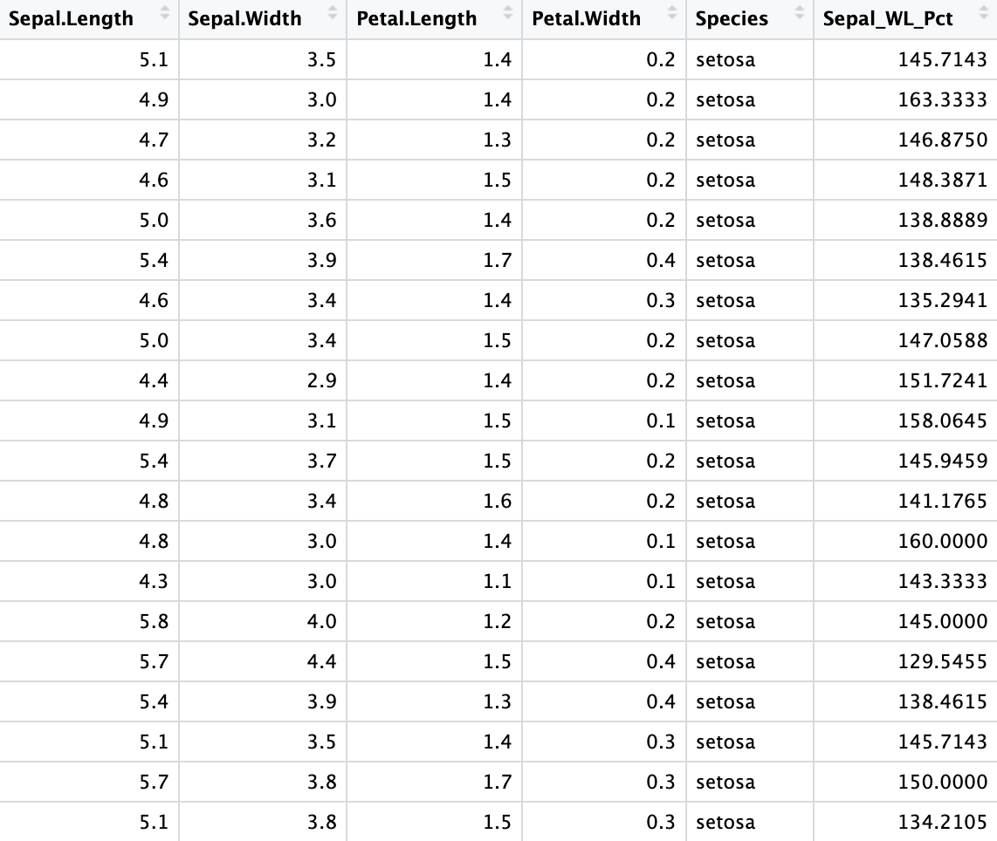
Introduction to dplyr (“The plier”)
3. mutate(): create new column based on existing columns
>
IRIS_SepalMutate_DF ← iris %>%
mutate(Sepal_WL_Pct = (Sepal.Length/Sepal.Width)*100))
>
view(iris)
New column name
Formula to derive values in new column
Fundamental grammar for data manipulation in R
Functions/commands for data manipulation
Summoned by calling library(dplyr) in script

Slide 10
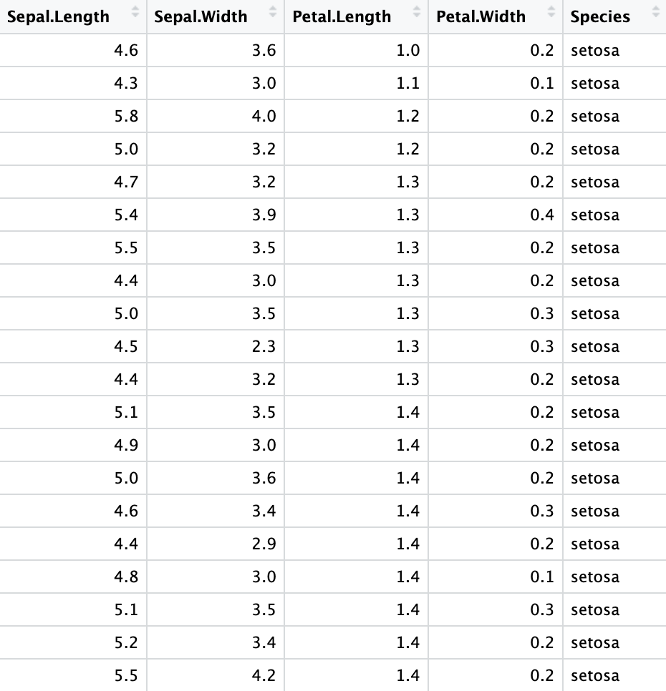
Introduction to dplyr (“The plier”)
4. arrange(): sort rows based on values in one or more specified columns
>
>
IRIS_PetalLen_Arrange_DF ← iris %>%
arrange(Petal.Length)
view(iris)
Fundamental grammar for data manipulation in R
Functions/commands for data manipulation
Summoned by calling library(dplyr) in script

Slide 11
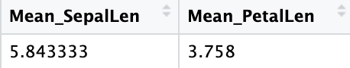
Introduction to dplyr (“The plier”)
5. summarise(): choose which columns to take aggregate
>
>
view(iris)
IRIS_Summary_DF ← iris %>%
summarise(Mean_SepalL = mean(Sepal.Length),
Mean_PetalL = mean(Petal.Length))
Fundamental grammar for data manipulation in R
Functions/commands for data manipulation
Summoned by calling library(dplyr) in script

Slide 12

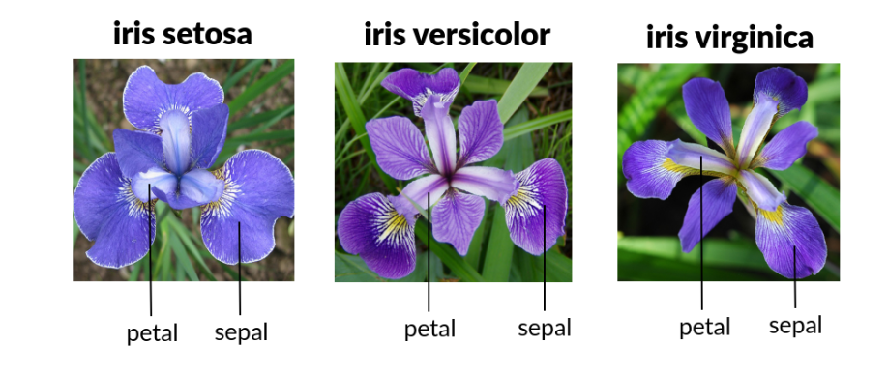
The iris data set
Why is the iris data set used for beginners?
Simple: 5 cols, 150 rows;
Easy to visualise: fixed no. of combinations to explore;
Significant:
One of first few data sets used for teaching
Widely used in machine learning algorithms
Techniques learnt here can be easily applied elsewhere
Introduced by Ronald A. Fisher in 1936.
Data set specifications:
Columns:
Sepals (bud envelopes)
Length
Width
Petals
Length
Width
Species
Setosa
Veriscolor
Virginica
Taken from Britannica.com

Slide 13
Prelims: Understanding your data
Crucial step to get a rough idea of data prior to diving deeper
Most common metrics:
mean ± standard deviation (‘spread’);
median ± interquartile range;
Once done with descriptive stats, always visualise your data.
Recommendation: load in your libraries first before starting to code.

Slide 14
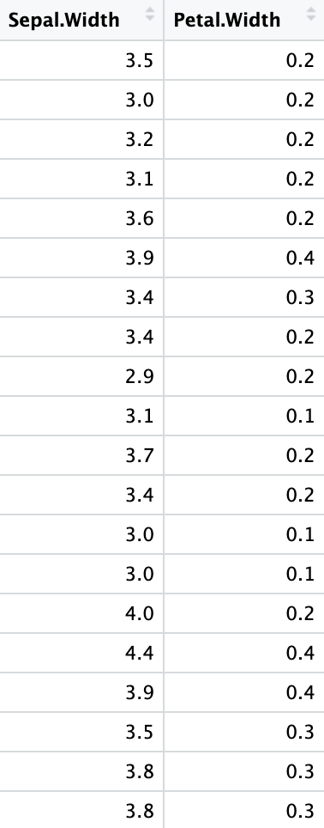
Task 1: Choosing the “width” columns in the data sets
IRIS_WidthCols_DF ← iris %>%
select(Sepal.Width, Petal.Width)

Slide 15
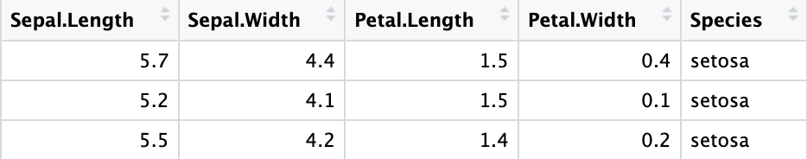
Task 2: Choosing sepal widths greater than 4.0mm
IRIS_SepalWidthFilt_DF ← iris %>%
filter(Sepal.Width > 4)

Slide 16
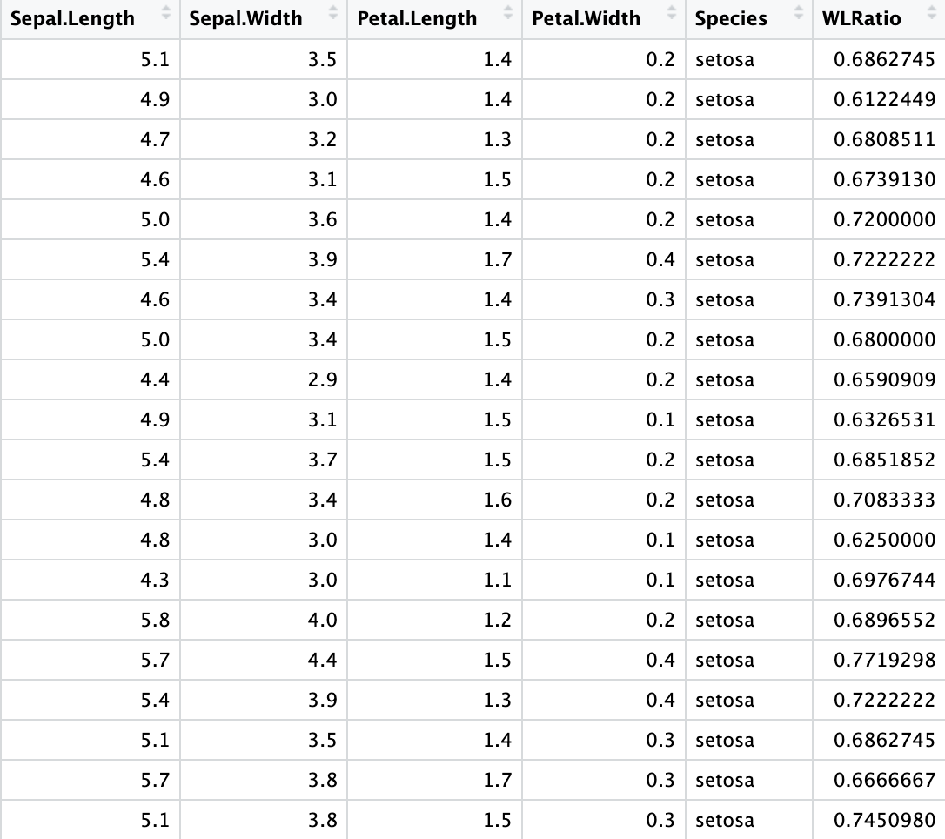
Task 3: Get sepal width to length ratio in a new column
IRIS_WLRatio_DF ← iris %>%
mutate(WLRatio = Sepal.Width/Sepal.Length)

Slide 17

Task 4: Sort data by Petal.Length
IRIS_PetalSorted_DF ← iris %>%
arrange(Petal.Length)

Slide 18
Task 4: Get the mean and median for widths columns.
IRIS_MeanMedianWidth_DF <- iris %>%
summarise(Mean_PetalWid = mean(Petal.Width, na.rm = TRUE),
Median_PetalWid = median(Petal.Width, na.rm = TRUE),
Mean_SepalWid = mean(Sepal.Width, na.rm = TRUE),
Median_SepalWid = median(Sepal.Width, na.rm = TRUE))

Slide 19
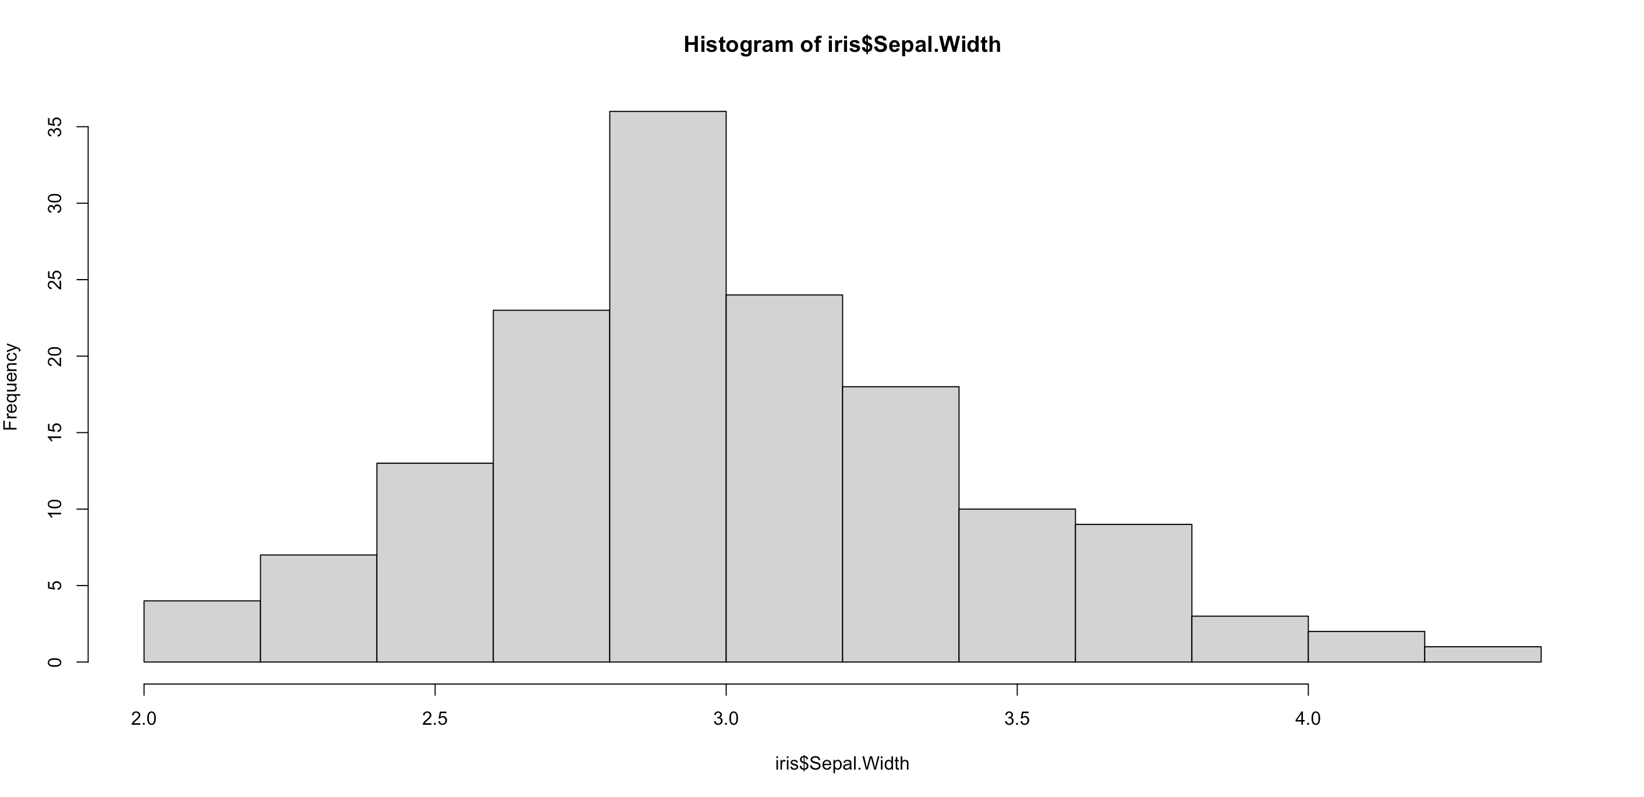
Task 5: Plot the distribution of sepal width
hist(iris$Sepal.Width)
From the iris data set, select Sepal.Width column

Slide 20

Questions?

